Slide 1
Course creator: Ruth Baker-Leask

Slide 2
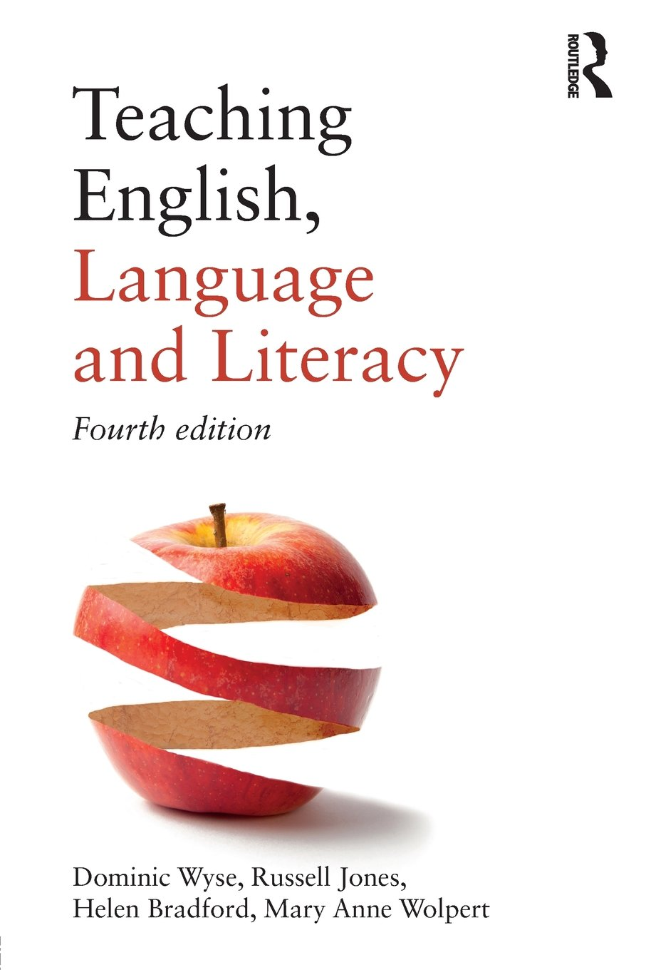
What to expect…
Empathy is an important part of being able to infer characters’ feelings and motives. Drama plays an important role in supporting children to feel empathy for characters.
‘[Drama] encourages them to see themselves in a wider social context and should help them become more sensitive to others.’
Wyse, D., Jones, R., Bradford, H. and Wolpert, M. A. (2013 Teaching English, Language and Literacy, 3rd ed. Abingdon: Routledge, pp 102-103

Slide 3
What is a conscience alley?
Conscience alley (also know as a thought tunnel or decision alley) is a great way of exploring a dilemma faced by the protagonist of a story.
The class forms two lines facing each other. One child is picked to be the protagonist who then walks down the ‘alley’ or passageway formed by the lines. As they walk, the other children tell them their thoughts, concerns and ideas related to the issue the character is facing. The children must use their voices and gesture to emphasise their ideas.
Once the main character has reached the end of the line, they must make a decision about how to act next, explaining their reasons to the rest of the class.

Slide 4
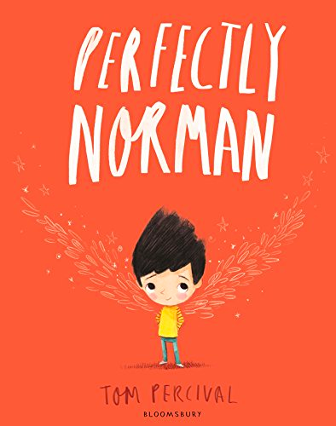
What’s your problem?
Two turtles, one hat:
A hidden pair of unexpected wings:

Slide 5
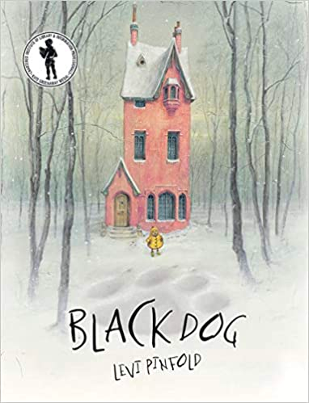
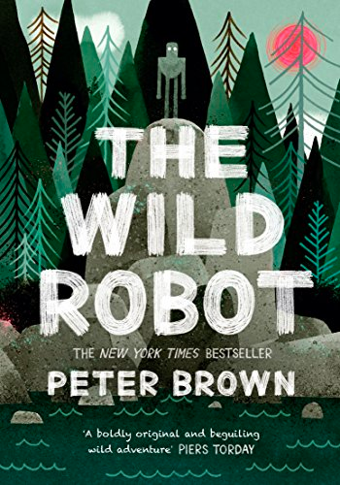
What’s your problem?
Facing a fear:
An adoption opportunity:

Slide 6
What’s your problem?
Helping a stranger:
Wartime dilemmas:

Slide 7
We Found a Hat by Jon Klassen
Share the hat. You won’t want to wear it every day.
Leave the hat behind. You have never needed a hat before so you can live without it.
Is a hat more important that a friend?
Take the hat; your friend can borrow it from time to time.
You keep the hat and your friend can have the next one you find.
A friend will understand that if the hat looks good on you, you should keep it.

Slide 8
The Wild Robot by Peter Brown
The Egg
As Roz stood in the rain, staring down at those poor, lifeless geese, her sensitive ears detected a faint peeping sound coming from somewhere nearby. She followed the peeps over to a clump of wet leaves on the ground. And when she peeled back the leaves, she discovered a single perfect goose egg sunk into the mud.
‘Mama! Mama!’ peeped a tiny muffled voice from within the egg.
Page 59

Slide 9
The Wild Robot by Peter Brown
You’re not a goose - you won’t know what to do.
How can you help others if all your time is spent with a baby?
You’re not programmed to be a mother…it’s not fair on the baby!
How will you teach him to fly? He needs to be looked after by a bird.
You are the cause of the problem so you should fix it.
You’re a loving robot; you will do a great job!
If you don’t look after the baby what will happen? Will he survive on his own?
Have you considered how much joy it will bring you?

Slide 10
Informal discussion and debate
Never mind that…
That might be the case; however…
That is only true when…
Have you considered that…?
I see things differently…
The most important thing to consider is…
It is unlikely/likely that…
It seems clear to me that…
The most sensible thing to do would be…

Slide 11
Thinking aloud
As experienced readers our internal reading voice is continually questioning, inferring and predicting the actions and motives of characters as a plot advances. Conscience alley is a great way to externalise this ‘reader’s voice’, particularly for children who have not yet experienced what it feels like to be fully engaged in a story when reading independently.

Slide 12
Benefits of drama in understanding narrative
Drama can support children to:
engage with texts that they might otherwise find ‘difficult’
reflect on the text as a whole, giving a well-informed, personal response
understand plot and action
understand the setting (time and place) and how this influences action
predict and discuss future actions and their consequences
recognise themes and subtext
understand and discuss mood atmosphere
understand characters’ traits and infer their feelings, motives and intentions
explore the language used by characters to express thoughts and feelings
feel more confident when answering inference questions

Slide 13
Thank you!
Course creator: Ruth Baker-Leask

